Slide 1
Warm Up
"He who does not have the courage to speak up for his rights cannot earn the respect of others.”
--Rene Torres
Copy the Quote.
What is Torres suggesting?
Do you agree/disagree with this statement? Why/why not?
Is this the only way to get respect? (To speak up for your rights) Are there any other ways to get respect?

Slide 2
The Civil Rights Movement
1945-1970

Slide 3
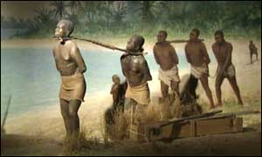
Enslavement begins…
Africans captured those of other tribes and sold them to European traders

Slide 4
Triangular Trade

Slide 5
Triangular Trade, cont…
Most of the enslaved people ended up in the Caribbean or South America
Most died there from the harsh conditions and brutal work
About 500,000 people were sent to North America
Reproduced; life expectancy equaled the white population

Slide 6
Three-fifths Compromise (1787)
The Framers of the Constitution decide African Americans will count as 3/5 a person when deciding representation for the census
Independence Hall, Philadelphia, Pennsylvania—Where the Constitution was signed

Slide 7
Slavery in America
Population increased from 698,000 in 1790 to almost 4 million in 1860
75% worked as agricultural laborers
A majority worked on plantations with 20-150 slaves

Slide 8
Free/Slave states, c. 1860

Slide 9
Reconstruction (1865-1877)
Reincorporating the South back into the United States after seceding from the Union
Addressed:
How Southern states would regain self-government and seats in Congress
The status of leaders of the Confederacy
The Constitutional and legal status of freed slaves
Some people disagreed with the way these issues were being handled
With this, the Ku Klux Klan was formed
Ku Klux Klan is Greek for “circle”

Slide 10
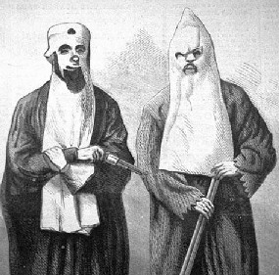
Formation of the Klan: December 24,1865
Pulaski, Tennessee; by ex Confederate soldiers
The sheets represented Confederate soldiers coming back from the dead
Started off as a hoax; then realized the scare tactics were actually working
Goal: restore white supremacy; social men’s group
declined from 1868 to 1870
destroyed by President Grant's passage and enforcement of the Force Acts of 1870 and 1871

Slide 11
The Force Act of 1870
Enforced in 1871
banned the use of terror, force or bribery to prevent someone from voting because of their race.
Other laws banned the KKK entirely.
Hundreds of KKK members were tried and thousands of Klansmen were arrested.
The first Klan was almost eradicated within a year of federal prosecution.
Nathan Bedford Forrest, first Grand Wizard of the KKK (left)

Slide 12
Warm Up
Why was the 3/5 Compromise a significant addition to the Constitution?
What is Reconstruction?
What did it address and who opposed it?
Why was the first KKK formed?
Who formed it?
What caused its downfall?

Slide 13
Black leaders
Many black leaders were elected to local and state governments during the Reconstruction era
2 senators (Mississippi) and 15 congressmen

Slide 14
Post Civil War America
Civil Rights Amendments:
13th (1865)—abolition of slavery
14th (1868)—citizenship for African Americans; equal protection clause
15th (1870)—African American right to vote

Slide 15
End of Reconstruction
Election of 1876
Disputes over electoral votes
Compromise of 1877
Even though Samuel Tilden (Democrat) won the popular vote and there was no majority electoral winner, Rutherford B. Hayes (Republican) became president
Hayes became president in exchange for pulling all federal troops out from South Carolina, Florida, and Louisiana
The South voted “solidly” democratic until 1964

Slide 16
Disenfranchisement
States devised ways to disenfranchise African Americans and prevent them from voting:
Literacy Tests
Poll Tax
Grandfather Clause

Slide 17
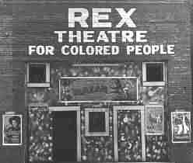
Segregation and Plessy vs. Ferguson (1896)
Plessy ruling: “Separate but Equal” accommodations ok
Jim Crow Laws—laws which enforced this case
Segregation was often called the Jim Crow system, after a character from the 1830s who was an African American slave
This demonstrated negative stereotypes of African Americans.
Maintained a second-class status for African Americans

Slide 18
Resurrection of the Klan
KKK resurrected in 1915-1944
Arose again on the popularity of “Birth of a Nation”
More romanticized version; had the most membership
Why join?
Social club aspect
Respectable white men
Patriotism
Family value
Anti-Catholic, immigrant, Semitic
Secret organization
Rises in Indiana, rural areas
Don’t like cars, radio (return to rural life)
Released in early 1915; first movie screened at the White House (Wilson)

Slide 19
Downfall of the Second Klan
Relation to the Klan of the South
Respect, honor, chivalry
Downfall during Great Depression and WW2
KKK marches down Pennsylvania Ave, 1926

Slide 20
Establishment of the NAACP
Est. 1909
National Association for the Advancement of Colored People
Many whites were vital to the founding of the NAACP

Slide 21
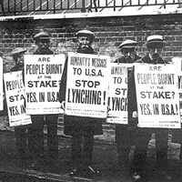
NAACP and lynching
Lynching—killing people as a mob action…most often associated with hanging, although it often included burning and various types of torture.
Often rare for culprits of lynching to receive punishment
Spent more than a decade trying to get an anti-lynching law passed
The NAACP regularly displayed a black flag stating "A Man Was Lynched Yesterday" from the window of its offices in New York to mark each lynching.

Slide 22
Great Migration
1910-1940
Movement of African Americans from the South to the industrialized North
Took advantage of employment opportunities set forth by World War I
Reasons for moving:
Racism
Employment opportunities
Education

Slide 23
Warm Up
How does Reconstruction come to an end?
Despite the 15th Amendment, many state governments devised ways to disenfranchise African Americans. List and explain these three methods.
Why is Plessy v. Ferguson (1896) significant?
What are the differences between the Klan of 1865 and 1915?
Explain the significance of the Great Migration.

Slide 24
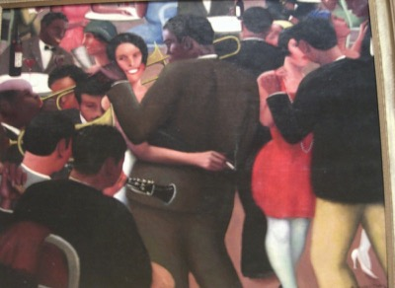
The Harlem Renaissance
1920-1935
Time where African-American art, literature, music, and culture began to flourish and was recognized by mainstream America

Slide 25
The Harlem Renaissance, cont.
As more and more educated and socially conscious African Americans settled in New York’s neighborhood of Harlem, it developed into the political and cultural center of black America
This generation refused to let the reality of racism and discrimination in the United States keep them from pursuing their goals.
Langston Hughes, famous African American poet

Slide 26
The Decline of the Renaissance
During the Great Depression of the 1930s, organizations such as the NAACP and the National Urban League, which had actively promoted the Renaissance in the 1920s, shifted their focus to economic and social issues.
Impact:
1980s/90s literature: Alice Walker (The Color Purple), Toni Morrison (The Bluest Eye, Beloved)
New Media, such as with director Spike Lee (“Summer of Sam”, “Jungle Fever”, “Malcolm X”)
Zora Neale Hurston, writer, Their Eyes Were Watching God

Slide 27
The Scottsboro Boys
Location: Scottsboro, Alabama
Situation: March 1931, nine black teenagers were taken off a freight train in Alabama
Charge: rape 1931: 8/9 black youths aged 13-21 sentenced to death
two white women accused them of rape… there was overwhelming evidence that they had not even been raped at all
Problem? ALL WHITE JURY
Supreme court overturned the convictions in 1932
NAACP and the Communist Party provided financial assistance
They were never acquitted, but they all eventually gained their freedom.
The last of the Scottsboro defendants did not leave prison until 1950
The Scottsboro Boys with their lawyer, Samuel Leibowitz. Because of his impeccable record, the International Labor Defense hired him, knowing he would not be paid for his service. This is the first case Leibowitz lost in 15 years.

Slide 28
Black Groups for Equality
In 1910, the National Urban League was created to help African Americans make the transition to urban, industrial life.
In 1942, the Congress of Racial Equality (CORE) was founded to challenge segregation in public accommodations in the North.
CORE initiated the March on Washington and Freedom Rides

Slide 29
Brown vs. Board of Education of Topeka (1954)
In May 1954, the Court issued its landmark ruling in Brown v. Board of Education of Topeka, stating racially segregated education was unconstitutional, thus overturning the Plessy decision.
White Southerners were shocked by the Brown decision.

Slide 30
Brown v. Board lawyers
George E.C. Hayes, Thurgood Marshall and James M. Nabrit, the lawyers who led the fight before the U.S. Supreme Court for abolition of segregation in public schools.
Picture taken descending the steps of the Supreme Court in Washington, D.C. on May 17, 1954.
Thurgood Marshall eventually became the first African-American justice admitted to the Supreme Court in 1967 by President Lyndon B. Johnson

Slide 31
The Murder of Emmett Till August, 1955
14 year old boy from Chicago, Illinois visiting his uncle in Mississippi
Various stories, but many suggested he was dared to flirt with a white woman; he whistled at the grocery owner’s wife
Her husband grew enraged; wanted to “teach him a lesson”

Slide 32
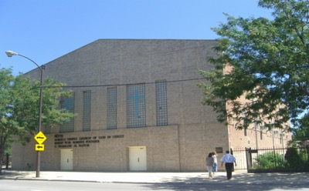
Till, cont.
Emmett was abducted and his body was found three days later in a river; he was beaten beyond recognition
His body was brought back to Chicago for burial
His mother insisted he have an open casket so “everyone can see what they did to my baby”
Many argue this initiated the Civil Rights Movement
The church where Till’s funeral was held. Chicago, Illinois. Summer, 2007

Slide 33
The Outcome
Emmett’s killers were brought to trial 24 days after his murder
They were found innocent by an all white jury of 12 men
67 minutes to deliberate
Look Magazine later paid the men $4,000 to tell their story
They explained exactly how they killed Till
Free from “double jeopardy”—being tried for the same crime twice

Slide 34
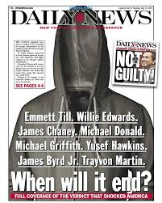
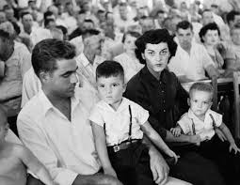
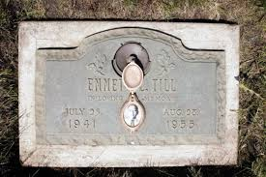
Admission of lying:
In 2017, author Timothy Tyson released details of a 2008 interview with Carolyn Bryant, during which she disclosed that she had fabricated the most sensational part of her testimony. Tyson stated: "she said with respect to the physical assault on her, or anything menacing or sexual, that that part isn't true". She also said: "nothing that boy did could ever justify what happened to him".

Slide 35
Warm Up
Why is the Harlem Renaissance significant?
Why was the National Urban League and CORE founded?
Why was the Brown v. Board case significant? Why was this case not successful in achieving its goal?
How could the murder of Emmett Till perhaps have been a contributing factor to the Civil Rights Movement?

Slide 36
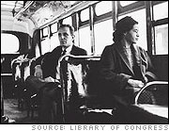
Rosa Parks: December 1, 1955
Rosa Parks, a member of the Montgomery, Alabama, branch of the NAACP, was told to give up her seat on a city bus to a white person.
When Parks refused to move, she was arrested.
The local NAACP, led by Edgar D. Nixon, recognized that the arrest of Parks might rally local African Americans to protest segregated buses.

Slide 37
The Montgomery Bus Boycott: December 5, 1955—December 20, 1956
Segregation bus laws were the most hated and humiliating in Montgomery
Women at Alabama State University call for bus boycott
This date corresponded to the beginning of Rosa Parks’ trial
Complaints against bus company:
Physical torture
Wanted drivers to come to black neighborhoods with more stops
Wanted seats to be first come, first served…not “white” or “colored” sections
COURTESY

Slide 38
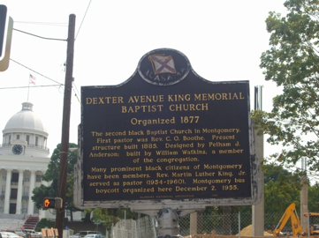
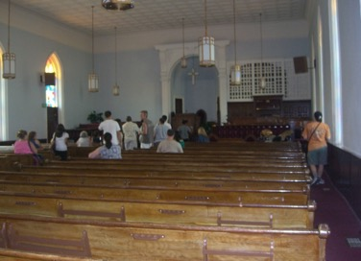
Dexter Avenue Baptist Church
Between Rosa Parks’ arrest and the boycott, ministers met at the Dexter Avenue Baptist Church…where they elected its young minister as the leader of the movement—Martin Luther King, Jr.

Slide 39
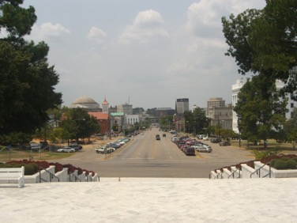
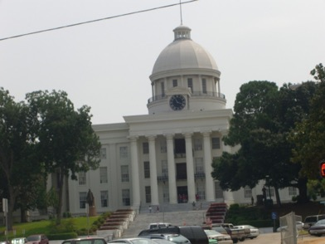
Montgomery, Alabama
Up the street from Dexter, is the Montgomery capital building

Slide 40
The Boycott, cont.
Taxi drivers were not allowed to give rides to any protestors or they would be fined
Instead, people worked together and formed carpools to help each other out
Violence increased as a result of the boycotts
The boycott ended when the city of Montgomery initiated an ordinance that allowed black bus passengers to sit virtually anywhere they wanted
By blacks not riding the city busses, it ended up costing the city of Montgomery over $1 million…75% of bus riders were black

Slide 41
Desegregating Little Rock, Arkansas: 1957
After the Supreme Court ruled in Brown v. Board, the Little Rock school district decided to voluntarily desegregate Little Rock Central High School
150 black students volunteered→10→9 students eventually went to school

Slide 42
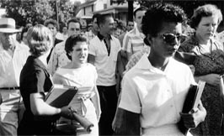
The Little Rock 9
Refers to the 9 students who desegregated the school
The Governor of Arkansas, Orville Faubus called the National Guard to prevent their entry
President Eisenhower sent in the army to take the students to school

Slide 43
The Little Rock 9
The students encountered hatred throughout the school year
In order to avoid desegregating other schools, the governor closed all Little Rock schools for the following school year starting in September, 1958
The schools were reopened in August, 1959 after the Supreme Court ruled that closing the schools was unconstitutional

Slide 44
The Little Rock 9 comes to Taft!

Slide 45
Extra Credit Opportunity!
Dr. Roberts will be hosting a LIVE zoom on May 14th at 3:00pm.
Register for the zoom here: https://zoom.us/meeting/register/tJ0sf-CgqT0vH9WF7u1bP-gQ_bcpMcC0pdv9
(you’re going to have to erase my info and register with your name, email, etc). If you have trouble with the link, let me know and I’ll forward the email to you!
Watch/pay attention to his zoom and do a one page write up explaining what he discussed and how it has inspired you.
I’ll be in the zoom too!

Slide 46
Martin Luther King, Jr. and non-violent protest
this was the only solution that could cure society’s evil and create a just society.
As King emerged as a leader in the civil rights movement, he put his belief into action and proved this was effective to combat racial segregation
Learned of this idea from Gandhi

Slide 47
Sit-ins
The sit-ins were very significant to the movement. They symbolized a change in the mood of African-American people.
Up until 1960 no one actively did anything to challenge segregation

Slide 48
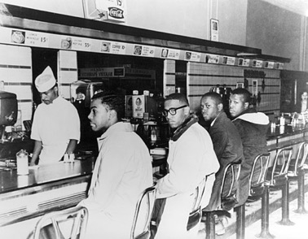
Sit-ins: Greensboro, North Carolina, February 1,1960
Where: the white-only Woolworth’s lunch counter
Who: 4 male freshmen from North Carolina A&T State University
What: told they wouldn’t be served; refused to leave
Significance: this idea spread and became an active method of protest
The lunch counter at the Smithsonian in Washington, D.C. today

Slide 49
Warm Up
Why did African Americans boycott the Montgomery bus system for over a year?
How did Martin Luther King, Jr. get involved in the Civil Rights Movement?
Why were sit-ins a popular method of protest?
What was the most significant “sit-in”? What happened?

Slide 50
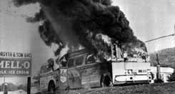
Freedom Rides, Summer, 1960
Over the spring and summer, student volunteers began taking bus trips through the South to test out new laws that prohibit segregation in interstate travel facilities, which includes bus and railway stations.
Attacked by angry mobs along the way
Sponsored by CORE and the Student Nonviolent Coordinating Committee (SNCC)
Involved more than 1,000 volunteers, black and white.
Firebombing in Anniston, Alabama

Slide 51
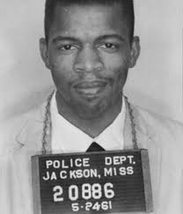
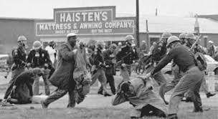
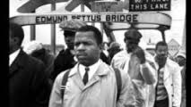
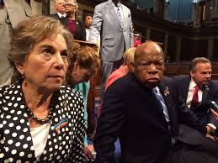
Representative John Lewis
On the first Freedom Ride
Chairman of SNCC
Spoke at 1963 March on Washington (youngest speaker of the day and the only one still alive today)
Participated in 1965 Selma-to-Montgomery March
1986: Elected to Congress from Georgia
2016: sit-in on the House Floor—allow a vote on safety gun legislation

Slide 52
Integrating the University of Georgia: Fall, 1961
Charlayne Hunter-Gault and Hamilton E. Holmes were the first African-Americans to attend
The academic building at the University of Georgia where they registered for classes was renamed the Hunter-Holmes Academic Building in 2001
Hunter-Gault worked for CNN and currently works for National Public Radio. She has received numerous Peabody Awards for Journalism and Emmy awards

Slide 53
Integration of the University of Mississippi (Ole Miss): October 1, 1962
James Meredith became the first black student to enroll at the University of Mississippi
He tried to enroll before but was denied twice
Violence and riots surrounding the incident caused President Kennedy to send 5,000 federal troops.

Slide 54
January 14, 1963
Inauguration Speech as Governor of Alabama, George Wallace
“Segregation now, segregation forever”
Rally cry for those opposed to integration and the Civil Rights Movement

Slide 55
The Birmingham Campaign: 1963-1964
“Bombingham”—so many bombs went off in the city, this became the nickname
Goal: the desegregation of Birmingham’s downtown merchants
nonviolent methods of confrontation:
sit-ins
march to the county building to mark the beginning of a drive to register voters

Slide 56
Mass protest
However, the city was able to secure an injunction barring all such forms of protest
Believing it was unconstitutional, people prepared for mass arrests in order to protest
Martin Luther King, Jr. volunteered to be the first arrested on April 12, 1963

Slide 57
In Jail:
While in jail, Dr. King wrote “Letter from a Birmingham Jail” on the margins of newspapers while he was in solitary confinement
King was released April 19, 1963

Slide 58
The Children’s March
The movement was losing steam, so SCLC organizers came up with a controversial idea: enlist children
They got this idea out through the radio with code words
More than 1,000 students skipped school on May 2, 1963 to join in on demonstrations

Slide 59
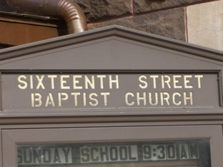
The second day…
On the first day, the police acted with restraint, the second day was different
Another 1000 students came the following day and met at the 16th St. Baptist Church
When they started marching, the City Commissioner for Public Safety, Eugene “Bull” Connor unleashed police dogs and water hoses on the students

Slide 60
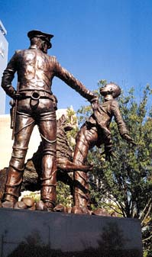
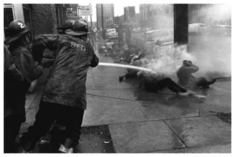
The March Turned Violent
Problem: TV cameras broadcast to the nation the scenes of water from fire hoses knocking down schoolchildren and dogs attacking individual demonstrators.
Public outrage forced the Kennedy Administration to intervene in the negotiations between the white business community and the SCLC

Slide 61
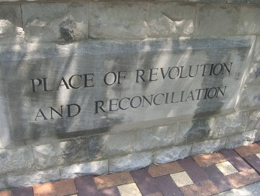
What happened as a result?
May 10, 1963
Agreement to desegregate the lunch counters and other public accommodations downtown, to create a committee to eliminate discriminatory hiring practices, to arrange for the release of jailed protesters, and to establish regular means of communication between black and white leaders.
At the front of Kelly Ingram Park, Birmingham, Alabama—where the march took place

Slide 62
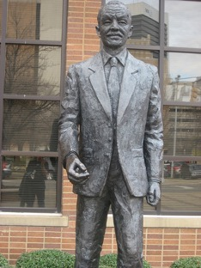
Response…
Reverend Fred Shuttlesworth publicly disagreed with this…he knew of the white Birmingham community’s “good faith”
Many whites in Birmingham were not happy with this agreement either
He passed away in 2011
Statue of Shuttlesworth outside the Birmingham Civil Rights Museum—across the street from Kelly Ingram Park and the 16th St. Baptist Church
Mrs. Kissen in Birmingham meeting Rev. Shuttlesworth (and his wife) in Summer, 2007

Slide 63
The Murder of Medgar Evers
World War II Vet
Battle of Normandy
Field Secretary for Miss. Branch of NAACP
Worked to get James Meredith admitted to Ole Miss
Assassinated on his driveway in Jackson, Miss.; 37 years old
June 12, 1963
Hours after President Kennedy’s televised Civil Rights Address
Buried at Arlington National Cemetary with military honors
Byron De La Beckwith tried for his murder
All white jury deadlocked in April 1964
New Evidence discovered and he was retried in June 1994 (“Ghosts of Mississippi)
Found GUILTY and was in prison until his death in January, 2001

Slide 64
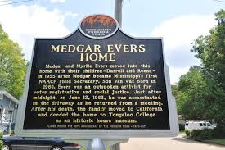
Medgar Evers

Slide 65
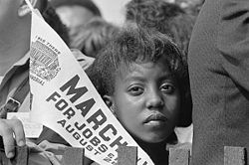
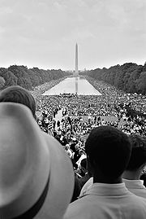
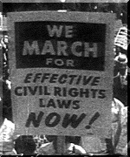
The March on Washington: August, 1963
About 200,000 people attending
Theme: “jobs, justice, and peace”
Congregated at the Lincoln Memorial, where participants listened as Martin Luther King delivers his famous “I Have a Dream" speech.
Credited with helping to pass the Civil Rights Act of 1964 and the Voting Rights Act of 1965

Slide 66
Warm Up
What was the goal of the Freedom Rides?
What was the goal of the Birmingham campaign?
Why were students important to the movement? What happened as a result of their involvement?
Would you categorize the Birmingham Campaign as a success or a failure? Explain.

Slide 67
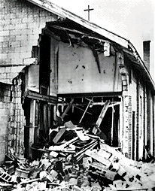
Bombing of the 16th St. Baptist Church: September 15, 1963
Members of the Ku Klux Klan bombed the 16th St. Baptist Church
4 young girls were killed. They were attending Sunday school classes

Slide 68
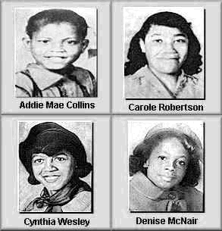
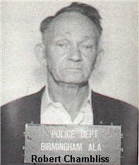
A witness identified Robert Chambliss as putting the box (which contained the bomb) under the stairs next to the church.
He was arrested for the bombing, but was found innocent with a $100 fine
In November, 1977 Chambliss was tried once again. Then aged 73, Chambliss was found guilty and sentenced to life imprisonment.
The FBI kept evidence from the prosecutors
Chambliss died in an Alabama prison on October 29, 1985.
Denise McNair was a former classmate of Secretary of State, Condoleezza Rice

Slide 69
Events of 1964:
January 23rd:
24th Amendment Passed
Abolishes the poll tax
Way of disenfranchising African-Americans…charged people to vote
July 2:
LBJ signs the Civil Rights Act of 1964
prohibits discrimination of all kinds based on race, color, religion, or national origin. The law also provides the federal government with the powers to enforce desegregation.

Slide 70
Freedom Summer
Freedom Summer—When black and white college students from the east coast traveled to the South to register blacks to vote
August 4, 1964:
Bodies of 3 men (two Jewish men and one black man) were discovered in a dam
James E. Chaney, 21; Andrew Goodman, 21; and Michael Schwerner, 24
They were working to register black voters in Mississippi
On June 21 went to investigate the burning of a black church

Slide 71
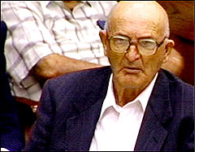
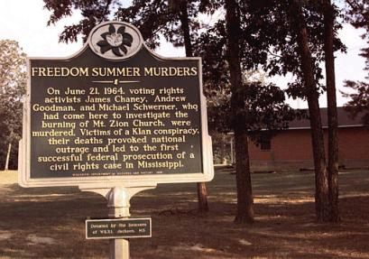
Arrested by the police on speeding charges, incarcerated for several hours, and then released after dark into the hands of the Ku Klux Klan, who murdered them.
The ringleader of the murders, Edgar Ray Killen, was convicted on June 21, 2005, the 41st anniversary of the crimes
“Mississippi Burning” was based on this event
Top: the boys’ car as it was found
Top: Killen sits trial

Slide 72
Malcolm X
Born Malcolm Little; changed his last name because “Little” was a slave owners last name
While serving a prison term, he became a Muslim preacher and after his release he became very prominent with the Nation of Islam
Had a “falling out” with the leader Elijah Muhammad

Slide 73
Martin vs. Malcolm
March 26, 1964: only time the two men met. They were in DC listening to the Senate debate on the Civil Rights Act of 1964.
They met for a minute; long enough for a picture

Slide 74
Diverse Beliefs:
Martin Luther King, Jr.
Favored non-violence
Favored interracial organizing
Response to Malcolm X:
"I have often wished that he would talk less of violence, because violence is not going to solve our problem," King noted. "And, in his litany of articulating the despair of the Negro without offering any positive, creative alternative, I feel that Malcolm has done himself and our people a great disservice. Fiery, demagogic oratory in the black ghettos, urging Negroes to arm themselves and prepare to engage in violence, as he has done, can reap nothing but grief."
Malcolm X
Favored armed self-defense
Against white allies
“By any means necessary”
Response to March on Washington:
"No sane black man really wants integration! No sane white man really wants integration. . . . The honorable Elijah Muhammad teaches that for the black man in America the only solution is complete separation from the white man!"

Slide 75
Assassination of Malcolm X: February 21, 1965
Murdered in Manhattan by Black Muslims

Slide 76
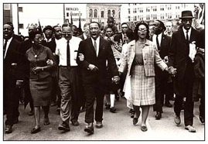
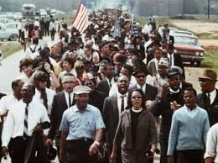
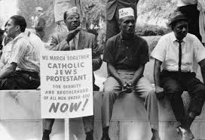
Selma to Montgomery March: March 7, 1965
525 to 600 civil rights marchers headed east out of Selma on Highway 80
Goal: to ask Governor George Wallace to protect black registrants
Crossed the Edmund Pettus Bridge (Civil War Confederate General/KKK Grand Dragon—Change the name, 2015?)
3 separate marches; many were beaten and killed
Known as “Bloody Sunday”

Slide 77
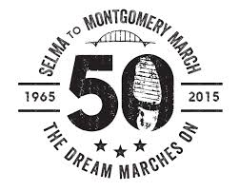
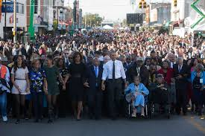
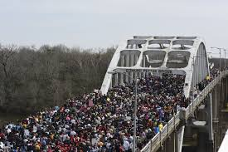
Commemorating the March: The 50th Anniversary

Slide 78
Voting Rights Act of 1965
outlawed discriminatory voting practices that had been responsible for the widespread disenfranchisement of African Americans
Including:
Poll tax
Literacy test

Slide 79
Formation of the Black Panthers
Founded in Oakland, California in October, 1966
established to promote Black Power and self-defense through acts of social agitation
active in the United States from the mid-1960s into the 1970s
Initially called for the protection of black neighborhoods and fought against police brutality
Some members openly disagreed with the views of the leaders.

Slide 80
Warm Up
1. What did the Civil Rights Act of 1964 do? The Voting Rights Act of 1965?
2. What was Freedom Summer? What incident happened during the summer of ’64?
3. How did the ideas of Malcolm X and Martin Luther King, Jr. differ?
4. What was the goal of the Selma to Montgomery March?

Slide 81
Loving v. Virginia (1967)
the Supreme Court rules that prohibiting interracial marriage is unconstitutional
Sixteen states that still banned interracial marriage at the time are forced to revise their laws

Slide 82
Going to Memphis: The Poor People’s Campaign, 1968
MLK, Jr. went to Memphis on behalf of economic injustice, specifically for sanitation works to get a minimum wage
The 1968 Poor People’s Campaign did not focus on just poor black people but addressed all poor people of every minority. Poor Mexicans, Puerto Ricans, American Indians, and even poor whites were included in the campaign.

Slide 83
April 3, 1968
Men and women packed the Mason Temple because they heard King was supposed to speak
That night he delivered his famous “I’ve been to the Mountaintop” speech

Slide 84
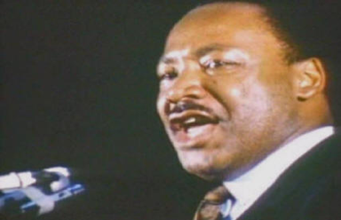
Toward the end of the speech, King refers to threats against his life and uses language that seems to foreshadow his impending death:
"And then I got to Memphis. And some began to say the threats, or talk about the threats that were out. What would happen to me from some of our sick white brothers? Well, I don't know what will happen now. We've got some difficult days ahead. But it doesn't matter with me now. Because I've been to the mountaintop. And I don't mind. Like anybody, I would like to live a long life. Longevity has its place. But I'm not concerned about that now. I just want to do God's will. And He's allowed me to go up to the mountain. And I've looked over. And I've seen the promised land. I may not get there with you. But I want you to know tonight, that we, as a people, will get to the promised land. So I'm happy, tonight. I'm not worried about anything. I'm not fearing any man. Mine eyes have seen the glory of the coming of the Lord.” (play speech)

Slide 85
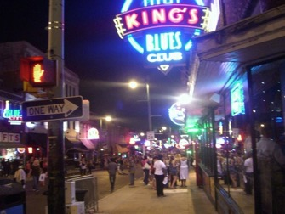
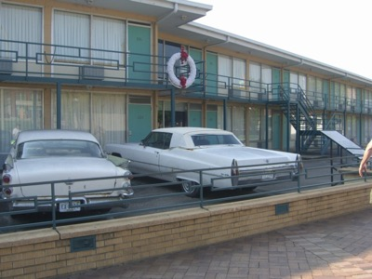
The Lorraine Motel
One of the few motels open to blacks
On a side street walking distance to Beale St.
Famous blacks stayed there such as Nat “King” Cole and Louis Armstrong
Beale St., Summer, 2007

Slide 86
April 4, 1968
MLK, Jr. was going to dinner at his friend, Reverend Kyle’s house
Mrs. Kissen and Reverend Kyle, Summer 2007

Slide 87
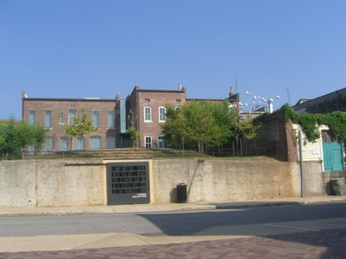
The Assassination
MLK stepped outside and was shot
He was 39
What the men were pointing at—where the shots came from (middle building, last window on the right)

Slide 88
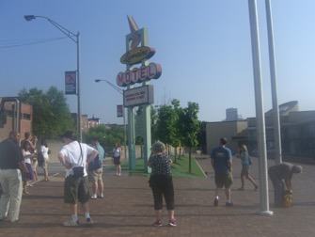
The Lorraine Today
The façade of the Lorraine today looks exactly as it did the day King was shot…down to the cars in front
To the left is the National Civil Rights Museum which goes through the Civil Rights Movement and ends at the room where MLK was staying…the sheets haven’t been moved

Slide 89
Following the Assassination
James Earl Ray was convicted of King’s murder
He said he was forced to confess
On his deathbed, he said he didn’t do it
King’s family believed Ray
Many people felt the Civil Rights Movement ended with King’s death

Slide 90
Immediate Effects— RFK speech
Before boarding a plane to Indianapolis, RFK delivered a last speech and told the crowd that MLK had been shot
Once the audience quieted down Kennedy acknowledged that many in the audience would be filled with anger, especially since the assassin was believed to be a white man
“But remember my brother was killed by a white man”(play speech)

Slide 91
Immediate Effects— Riots
Led to riots in more than 60 cities…
Except none in Memphis, Indianapolis and Boston
After the assassination, the city of Memphis quickly settled the strike, on favorable terms to the sanitation workers

Slide 92
Civil Rights Act of 1968, aka the Fair Housing Act passed April 11, 1968
prohibited discrimination concerning the sale, rental, and financing of housing based on race, religion, national origin
as of 1974, gender
as of 1988, the act protects the handicapped and families with children
It also provided protection for civil rights workers

Slide 93
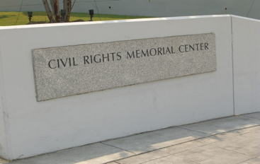
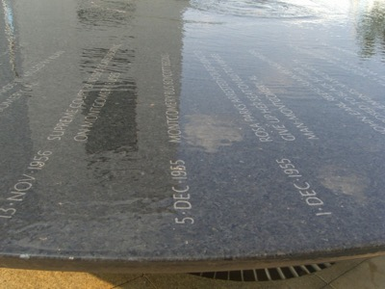
Remembering the Civil Rights Movement: Montgomery, Alabama
Below: This fountain was designed by the same woman who designed the Vietnam Wall in Washington, D.C.—Maya Lin

Slide 94
Question:
When do you think the Civil Rights Movement ended? Or…do you think it still continues?
Justify your answer citing three examples, describing each and how it relates to your perspective.

