Slide 1
Warm Up—8/27/19
List everything you know about the Puritans and their beliefs.

Slide 2
The Puritans:
Were they selfish or selfless?

Slide 3
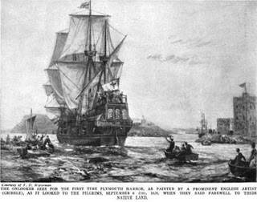
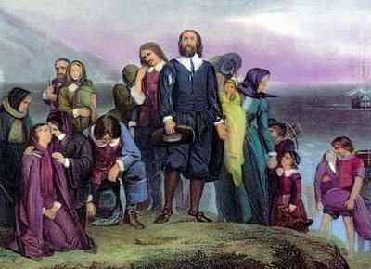
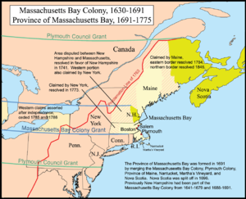
In America: The Pilgrims vs. The Puritans
Pilgrims
1609: moved to Holland; afraid their children were becoming assimilated; came to the “New World” in 1620 on Mayflower
Settled in Plymouth, Mass.
Wanted to “separate” themselves from the Church of England
Puritans
Settled in New England, est. Massachusetts Bay; 1630
Dissatisfied with the Church of England; followers of Calvinism; wanted to “purify” the church
Leader: John Winthrop

Slide 4
Now that they’re here…
How should they act/behave?
Documents to help us understand their perspective:
“City Upon a Hill”—John Winthrop
“The Divine Right to Occupy the Land” –John Cotton

Slide 5
Review:
Based on their documents, how might the Puritans’ religion shape their actions in the new world?
How do you think the Puritans would have reacted to someone who strayed from the religion? Why?
Based on these documents, how do you think the Puritans reacted to the Native Americans they encountered?
Using evidence from the documents, answer: Were the Puritans selfish or selfless?

